Slide 1
Sequence Modeling và Mạng hồi quy (Recurrent Neural Network) Và LSTM
Nguyen Van Vinh
QAI, Fsoft

Slide 2
Nội dung trình bày
Sequence modelling
Recurrent Neural Network
The vanishing/exploding gradient problem
LSTM
Applications for RNN, LSTM
Thực hành: RNN, LSTM for Sentiment analysis, Name entity recognition.

Slide 3
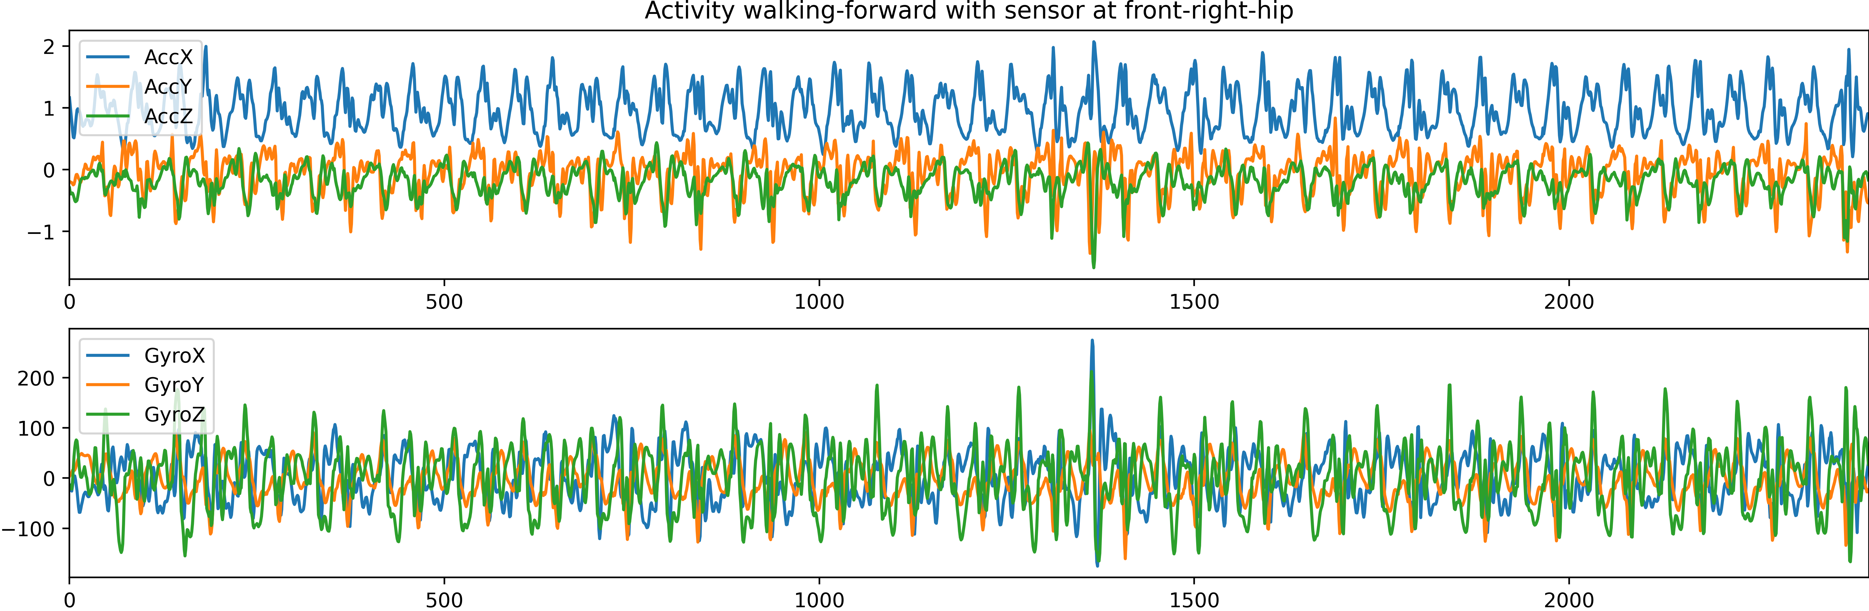
Sequence Data
Time Series Data
Natural Language
Nguồn: https://dl.acm.org/doi/10.1145/2370216.2370438

Slide 4
Why Recurrent Neural Networks (No standard NN) ?
Not all problems can be converted into one with fixedlength inputs and outputs
Problems such as Speech Recognition or Time-series Prediction require a system to store and use context information
Simple case: Output YES if the number of 1s is even, else NO! 1000010101 – YES, 100011 – NO, …
Hard/Impossible to choose a fixed context window
There can always be a new sample longer than anything seen

Slide 5
What is RNN?
A recurrent neural network (RNN) is a type of artificial neural network which used for sequential data or time series data.
RNN take the previous output or hidden states as inputs. The composite input at time t has some historical information about the happenings at time T < t
RNNs are useful as their intermediate values (state) can store information about past inputs for a time that is not fixed a priori
Application:
Language translation.
Natural language processing (NLP).
Speech recognition.
Image captioning.

Slide 6
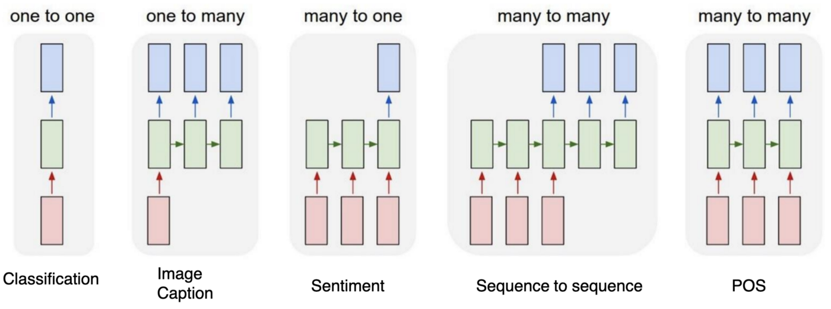
Types of RNN

Slide 7
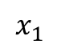
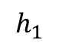
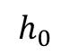
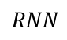
Recurrent Neural Network Cell
$$h_{0}$$
$$RNN$$
$$h_{1}$$
$$x_{1}$$

Slide 8
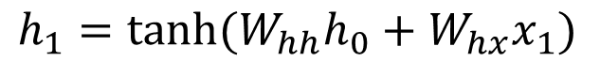
Recurrent Neural Network Cell
$$h_{1}=tanh⁡(W_{hh}h_{0}+W_{hx}x_{1})$$
$$h_{0}$$
$$RNN$$
$$h_{1}$$
$$x_{1}$$

Slide 9
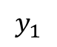
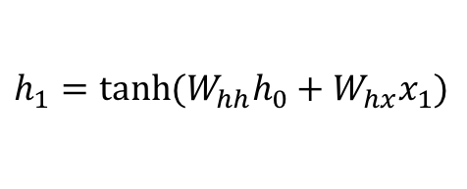
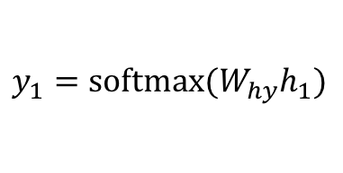
Recurrent Neural Network Cell
$$y_{1}$$
$$h_{1}$$
$$h_{0}$$
$$RNN$$
$$h_{1}$$
$$h_{1}=tanh⁡(W_{hh}h_{0}+W_{hx}x_{1})$$
$$x_{1}$$
$$y_{1}=softmax⁡(W_{hy}h_{1})$$

Slide 10
Recurrent Neural Network Cell
$$y_{1}$$
$$h_{1}$$
$$h_{0}$$
$$RNN$$
$$h_{1}$$
$$x_{1}$$

Slide 11
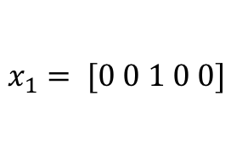
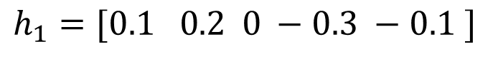
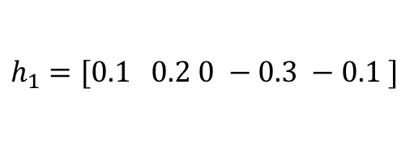
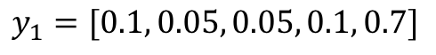
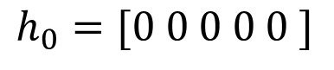
Recurrent Neural Network Cell
$$y_{1}=[0.1, 0.05, 0.05, 0.1, 0.7]$$
e (0.7)
$$h_{1}=[0.1 0.2 0 −0.3 −0.1 ]$$
$$h_{0}=[0 0 0 0 0 ]$$
$$RNN$$
$$h_{1}=[0.1 0.2 0 −0.3 −0.1 ]$$
$$x_{1}= [0 0 1 0 0]$$
a b c d e

Slide 12
Recurrent Neural Network Cell
$$y_{1}$$
$$h_{1}$$
$$h_{0}$$
$$RNN$$
$$h_{1}$$
$$x_{1}$$

Slide 13
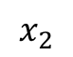
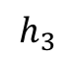
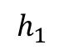
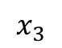
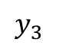
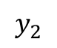
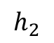
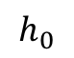
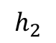
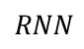
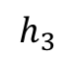
(Unrolled) Recurrent Neural Network
a
t
<<space>>
$$y_{1}$$
$$y_{2}$$
$$y_{3}$$
$$h_{1}$$
$$h_{2}$$
$$h_{3}$$
$$h_{0}$$
$$RNN$$
$$h_{1}$$
$$h_{2}$$
$$h_{3}$$
$$RNN$$
$$RNN$$
$$x_{1}$$
$$x_{2}$$
$$x_{3}$$
c
a
t

Slide 14
(Unrolled) Recurrent Neural Network
cat
likes
eating
$$y_{1}$$
$$y_{2}$$
$$y_{3}$$
$$h_{1}$$
$$h_{2}$$
$$h_{3}$$
$$h_{0}$$
$$RNN$$
$$h_{1}$$
$$h_{2}$$
$$h_{3}$$
$$RNN$$
$$RNN$$
$$x_{1}$$
$$x_{2}$$
$$x_{3}$$
the
cat
likes

Slide 15
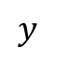
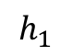
(Unrolled) Recurrent Neural Network
positive / negative sentiment rating
$$y_{}$$
$$h_{3}$$
$$h_{0}$$
$$RNN$$
$$h_{1}$$
$$h_{2}$$
$$h_{3}$$
$$RNN$$
$$RNN$$
$$x_{1}$$
$$x_{2}$$
$$x_{3}$$
the
cat
likes

Slide 16
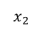
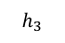
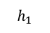
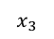
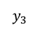
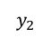
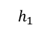
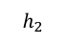
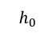
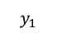
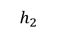
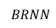
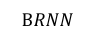
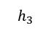
Bidirectional Recurrent Neural Network
$$y_{1}$$
$$y_{2}$$
$$y_{3}$$
$$h_{1}$$
$$h_{2}$$
$$h_{3}$$
$$h_{0}$$
$$BRNN$$
$$h_{1}$$
$$BRNN$$
$$h_{2}$$
$$BRNN$$
$$h_{3}$$
$$x_{1}$$
$$x_{2}$$
$$x_{3}$$
the
cat
wants

Slide 17
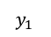
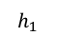
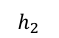
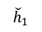
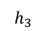
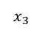
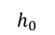
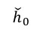














Stacked Recurrent Neural Network
$$y_{1}$$
$$y_{2}$$
$$y_{3}$$
$$h_{1}$$
$$h_{2}$$
$$h_{3}$$
$$h_{0}$$
$$RNN$$
$$h_{1}$$
$$RNN$$
$$h_{2}$$
$$RNN$$
$$h_{3}$$
$${\check{h}}_{1}$$
$${\check{h}}_{2}$$
$${\check{h}}_{3}$$
$${\check{h}}_{0}$$
$$RNN$$
$${\check{h}}_{1}$$
$$RNN$$
$${\check{h}}_{2}$$
$$RNN$$
$${\check{h}}_{3}$$
$$x_{1}$$
$$x_{2}$$
$$x_{3}$$
c
a
t

Slide 18


Slide 19

Overview of the feed-forward neural network and RNN structures
Nguồn: https://blog.floydhub.com/a-beginners-guide-on-recurrent-neural-networks-with-pytorch/

Slide 20

Backpropagation for RNNs

Slide 21
Qui tắc chuỗi đa biến
Nguồn: https://www.khanacademy.org/math/multivariable-calculus/multivariable-derivatives/differentiating-vector-valued-functions/a/multivariable-chain-rule-simple-version

Slide 22

Backpropagation for RNNs

Slide 23
Vectorization
E.g., looping over word vectors versus concatenating them all into one large matrix and then multiplying the softmax weights with that matrix:
Matrices are awesome!!! Always try to use vectors and matrices rather than for loops!
The speed gain goes from 1 to 2 orders of magnitude with GPUs!

Slide 24

Non-linearities, old and new

Slide 25
Parameter Initialization
You normally must initialize weights to small random values (i.e., not zero matrices!)
To avoid symmetries that prevent learning/specialization
Initialize hidden layer biases to 0 and output (or reconstruction) biases to optimal value if weights were 0 (e.g., mean target or inverse sigmoid of mean target)
Initialize all other weights ~ Uniform(–r, r), with r chosen so numbers get neither too big or too small
Xavier initialization

Slide 26
Optimizers
Usually, plain SGD will work just fine!
However, getting good results will often require hand-tuning the learning rate
E.g., start it higher and halve it every k epochs (passes through full data, shuffled or sampled)
For more complex nets and situations, or just to avoid worry, you often do better with one of a family of more sophisticated “adaptive” optimizers that scale the adjustment to individual parameters by an accumulated gradient
These models give differential per-parameter learning rates
Adagrad
RMSprop
Adam ← A fairly good, safe place to begin in many cases
…
Can just start them with an initial learning rate, around 0.001

Slide 27
Dropout
Preventing Feature Co-adaptation = Good Regularization Method! Use it widely!
Training time: at each instance of evaluation (in online SGD-training), randomly set 50% of the inputs to each neuron to 0
Nguồn: Dropout: “A Simple Way to Prevent Neural Networks from Overfitting”, Nitish Srivastava et el., https://jmlr.org/papers/volume15/srivastava14a/srivastava14a.pdf

Slide 28

Bài tập thực hành
RNN for sentiment
Data set: IMDB

Slide 29

The vanishing/exploding gradient problem

Slide 30

Vanishing gradient intuition

Slide 31

Vanishing gradient intuition

Slide 32

Vanishing gradient intuition

Slide 33

Vanishing gradient intuition

Slide 34



The vanishing gradient problem
Similar but simpler RNN formulation:
Total error is the sum of each error at time steps t
Hardcore chain rule application:

Slide 35




The vanishing gradient problem
Useful for analysis we will look at:
Remember
More chain rule, remember:
The gradient is a product of Jacobian matrices, each associated with a step in the forward computation.
Vanishing or exploding gradient

Slide 36
The vanishing gradient problem for language models
In the case of language modeling or question answering words from time steps far away are not taken into consideration when training to predict the next word
Example:
Jane walked into the room. John walked in too. It was late in the day. Jane said hi to ____

Slide 37
Vanishing/Exploding Solutions
Vanishing Gradient:
Gating mechanism (LSTM, GRU)
Attention mechanism (Transformer)
Adding skip connection through time
Better Initialization

Slide 38
Long Short-Term Memory RNNs (LSTMs)
A type of RNN proposed by Hochreiter and Schmidhuber in 1997 as a solution to the vanishing gradients problem.
Everyone cites that paper but really a crucial part of the modern LSTM is from Gers et al. (2000)
On step t, there is a hidden state h(t) and a cell state c(t)
Both are vectors length n
The cell stores long-term information
The LSTM can read, erase, and write information from the cell
The selection of which information is erased/written/read is controlled by three corresponding gates
The gates are also vectors of length n
On each timestep, each element of the gates can be open (1), closed (0), or somewhere in-between
The gates are dynamic: their value is computed based on the current context
“Long short-term memory”, Hochreiter and Schmidhuber, 1997. https://www.bioinf.jku.at/publications/older/2604.pdf
“Learning to Forget: Continual Prediction with LSTM”, Gers, Schmidhuber, and Cummins, 2000. https://dl.acm.org/doi/10.1162/089976600300015015

Slide 39

Long Short-Term Memory (LSTM)

Slide 40
Long Short-Term Memory (LSTM)
Chúng ta có thể thấy LSTM mô tả như sau:
Nguồn: http://colah.github.io/posts/2015-08-Understanding-LSTMs/

Slide 41

Long-Short Term Memory (LSTM)
Notes:
LSTM is a kind of RNN
LSTM is capable of learning long term dependencies

Slide 42

Architecture of LSTM cell

Slide 43

Architecture of LSTM cell

Slide 44

Architecture of LSTM cell

Slide 45

Architecture of LSTM cell

Slide 46

Architecture of LSTM cell
Conclusion:
Step 1: Forget gate layer.
Step 2: Input gate layer.
Step 3: Combine step 1 & 2.
Step 4: Output the cell state.

Slide 47

LSTM Variations: Gated Recurrent Units (GRU)
Proposed by Cho et al. in 2014 as a simpler alternative to the LSTM.
On each timestep t, we have input and hidden state x^{(t)} (no cell state h^{(t)}).
Nguồn: "Learning Phrase Representations using RNN Encoder–Decoder for Statistical Machine Translation", Cho et al. 2014, https://arxiv.org/pdf/1406.1078v3.pdf

Slide 48
Compare LSTM vs. GRU
GRUs train faster and perform better than LSTMs on less training data if you are doing language modeling (not sure about other tasks).
GRUs are simpler and thus easier to modify, for example adding new gates in case of additional input to the network. It's just less code in general.
LSTMs should in theory remember longer sequences than GRUs and outperform them in tasks requiring modeling long-distance relations.

Slide 49
How does LSTM can solve vanishing gradient?
The LSTM architecture makes it easier for the RNN to preserve information over many timesteps.
Ex., if the forget gate is set to 1 for a cell dimension and the input gate set to 0, then the information of that cell is preserved indefinitely.
In contrast, it’s harder for a vanilla RNN to learn a recurrent weight matrix W_{h} that preserves info in the hidden state
In practice, you get about 100 timesteps rather than about 7
LSTM doesn’t guarantee that there is no vanishing/ exploding gradient. But it provides an easier way for the model to learn long-distance dependencies.

Slide 50
Is vanishing/exploding gradient just a RNN problem?
No! It can be a problem for all neural architectures (including feed-forward and convolutional), especially very deep ones.
Due to chain rule / choice of nonlinearity function, gradient can become vanishingly small as it backpropagates
Thus, lower layers are learned very slowly (hard to train)
Solution: lots of new deep feedforward/convolutional architectures add more direct connections (thus allowing the gradient to flow)
Nguồn: "Deep Residual Learning for Image Recognition", He et al, 2015. https://arxiv.org/pdf/1512.03385.pdf

Slide 51
LSTMs: real-world success
In 2013–2015, LSTMs started achieving state-of-the-art results
Successful tasks include handwriting recognition, speech recognition, machine translation, parsing, and image captioning, as well as language models
LSTMs became the dominant approach for most NLP tasks
Now (2019–2022), other approaches (e.g., Transformers) have become dominant for many tasks
For example, in WMT (a Machine Translation conference + competition):
In WMT 2014, there were 0 neural machine translation systems (!)
In WMT 2016, the summary report contains “RNN” 44 times (and these systems won)
In WMT 2019: “RNN” 7 times, ”Transformer” 105 times
Nguồn: "Findings of the 2016 Conference on Machine Translation (WMT16)", Bojar et al. 2016, http://www.statmt.org/wmt16/pdf/W16-2301.pdf
"Findings of the 2018 Conference on Machine Translation (WMT18)", Bojar et al. 2018, http://www.statmt.org/wmt18/pdf/WMT028.pdf
"Findings of the 2019 Conference on Machine Translation (WMT19)", Barrault et al. 2019, http://www.statmt.org/wmt18/pdf/WMT028.pdf

Slide 52
Successful Applications of LSTMs
Speech recognition: Language and acoustic modeling
Sequence labeling
POS Tagging https://www.aclweb.org/aclwiki/index.php?title=POS_Tagging_(State_of_the_art)
NER
Phrase Chunking
Neural syntactic and semantic parsing
Image captioning: CNN output vector to sequence
Sequence to Sequence
Machine Translation (Sustkever, Vinyals, & Le, 2014)
Video Captioning (input sequence of CNN frame outputs)

Slide 53
Bài tập thực hành
LSTM for sentiment
Data: IMDB data set

Slide 54
Tổng kết bài giảng hôm nay
Recurrent Neural Network is one of the best deep NLP model families
Most important and powerful RNN extensions with LSTMs and GRUs
Apply RNN, LSTM for sentiment analysis and Name Entity problems

Slide 55
Question and Discussion!

